Slide 1
Problem Solving and Iteration
Mack 2023

Slide 2
Learning Objectives
Students will learn about the concept of opposition in game design by “programming” a balanced game of Us vs It.
Balancing the game is the primary output of this module.
By continually iterating, changing and playtesting their games, students will learn how to use the playtest > analyse > iteration loop to work towards putting the game’s players into a flow state (defined below).

Slide 3
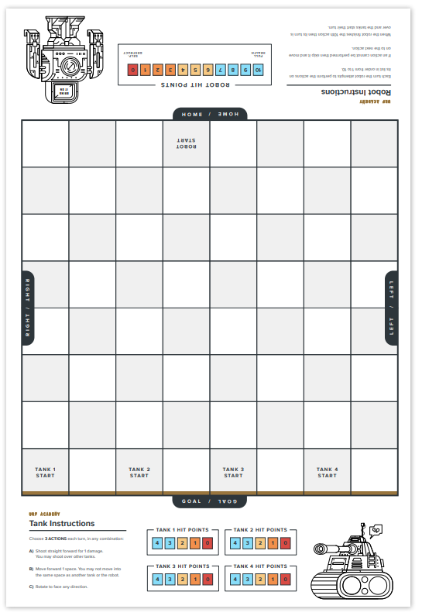
Setup
Split up into groups
Each Group gets a different action sheet
Each Group gets a robot and has to name it.

Slide 4
Game Premise
A group of scientists programmed a giant robot to protect their town from invaders. But something has gone horribly wrong and now the robot is charging towards the town, destroying everything in its path. Players must work together and each control a tank (four in total) to prevent the rogue robot from reaching their town.
The robot and four tanks alternate turns to see who reigns victorious.

Slide 5
Game Setup
Place the game boards together as shown in the diagram on the side with the pieces in their starting locations and tanks facing forwards

Slide 6
Rules
Robot executes its complete sequence by enacting the actions on the Action Order list in order.
The robot is not on the players’ team, but the players need to execute the robot’s action order.
Each of the tanks take their turn in order
Don’t alternate a robot’s turn in between each tank turn
Tanks can use up to 3 of their abilities (as indicated on their sheet) and can use multiple of the same ability in a row if they desire. Players are on the tank team
Repeat until a victor is decided.
The robot wins if it passes the goal line or if all the tanks are destroyed.
The tanks win if the robot is destroyed (hit points reach 0).

Slide 7
Five Whys
Five Whys is a problem solving technique pioneered and used to great success by Toyota founder Sakichi Toyoda.
Compared to modern standards, it is not the most robust problem solving framework, but it has great appeal for memorability and simplicity for URF Academy students.
Discovering the root cause of a problem is important to ensure that the actual problem is being treated, not the symptoms of a problem.
Treating the symptoms of a problem rather than the root cause will result in either the same problem reocurring or a different problem occurring due to the same root cause. In a professional setting, this costs time and resources.

Slide 8
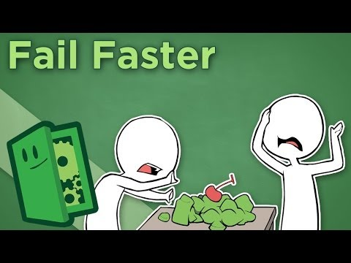
Failing Faster

Slide 9
Five Whys
Problem: Tanks Lost
Why did the tanks lose?
Why was the robot able to kill the tanks?
Why did it do too much damage?
Why did the robot have too many damage abilities?

Slide 10
Five Whys
Problem: Robot Lost
Why did the robot lose?
Why did the tanks kill the robot?
Why didn’t the robot kill the tanks or go to the goal?
Why did the robot keep running into walls?
Why did it keep using face left and move?

Slide 11
Balance
The goal is to make a “balanced” game. A balanced game is one where you could not tell whether the tanks or robots are winning until the very end.

Slide 12
Let’s Balance the Game
You can change any of the following:
The number of actions the robot conducts.
The order of the actions in the action order.
The actions in the action order.
The number of actions the tanks can take.
Or anything else you can think of!

